Slide 1

Working with NOSQL Database:
Spring Data MongoDB
Palak Nayak
Metadata Services

Slide 2
Why NoSQL (Not only SQL) Database
Dynamic Schemas
No predefined schema
Auto Sharding
Relational databases scales vertically which gets expensive quickly and places limits on scale
NoSQL database has the ability to scale horizontally by adding servers instead of concentrating more capacity in a single server.
Automatic Database Replication
More sophisticated NoSQL databases are fully self-healing, offering automated failover and recovery, as well as the ability to distribute the database across multiple geographic regions to withstand regional failures and enable data localization.
Integrated caching
No separate caching tier

Slide 3
Introduction to MongoDB
Some kinds of data are best represented by “documents”
Document Databases collects the information into denormalized structure (known as documents)
Example: Application that captures a college student's transcript.
Operations:
Retrieve transcripts given student’s name
Search across the transcripts for some common properties
What document database are not good for?
Data with complex relationships

Slide 4
SQL to MongoDB Mapping
SQL Terms | MongoDB Terms
Database | Database
Table | Collection
Row | Document
Column | Field
Index | Index
Primary Key | Primary Key
Transactions | Transactions

Slide 5
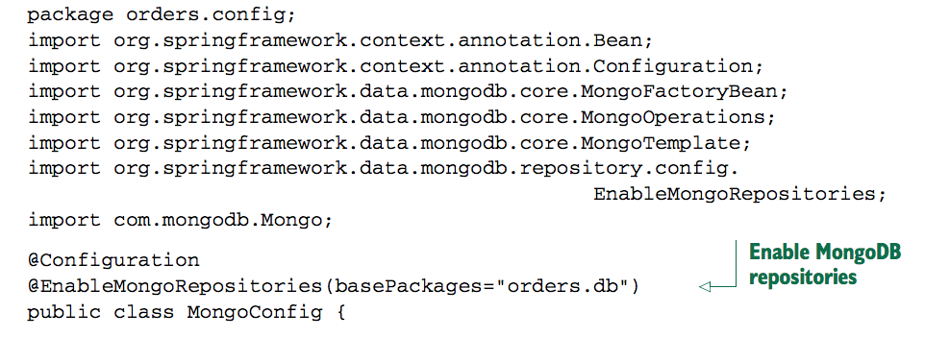
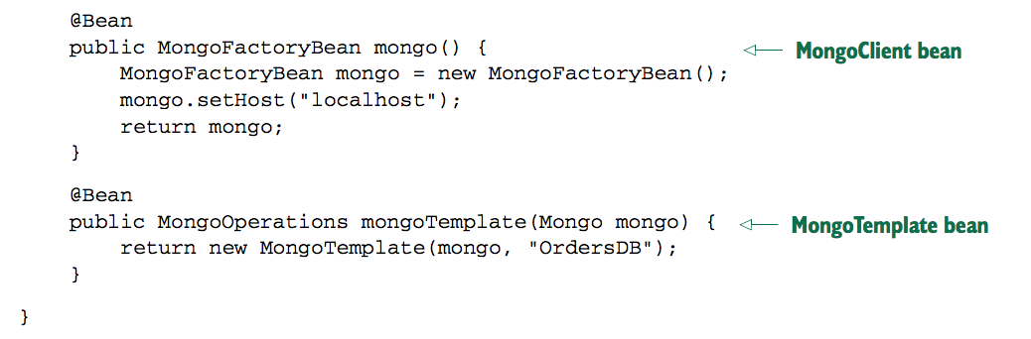
Spring Data MongoDB: Enable MongoDB

Slide 6
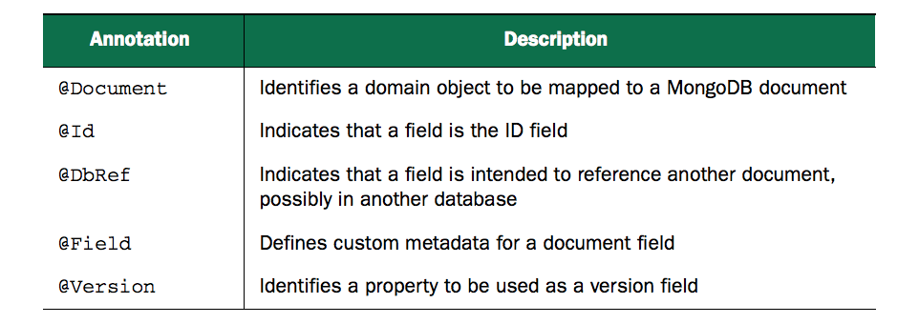
Object-to-document mapping
How do we map MongoDB Documents to Java Objects?
MongoDB doesn’t come with its own object-to-document mapping annotations.
Spring Data MongoDB provides handful of annotations to map Java types to MongoDB documents.

Slide 7
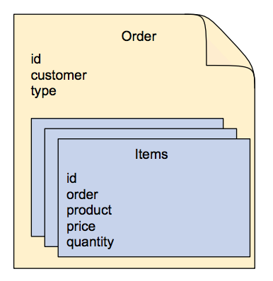
Documents in MongoDB
Related concepts ( such as items of an order) are embedded in the top-level document.
There’s no need for any annotations to designate the relationship.
Attributes here will be annotated with @Document and @Id
No need to annotate with @Document and @Id
Item will be never persisted as an independent document

Slide 8
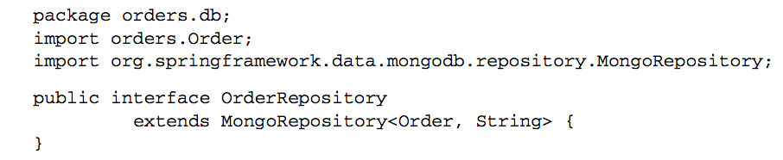
MongoDB Repository: Two Step Configuration
Extend MongoRepository to provide basic CRUD operations.
Enable Spring Data’s automatic repository generation with @EnableMongoRepositories
Document class
DataType of Id field
This will scans its base package for any interfaces that extend Spring Data JPA’s Repository interface. When it finds any interface extending Repository, it automatically (at application startup time) generates an implementation of that interface.

Slide 9
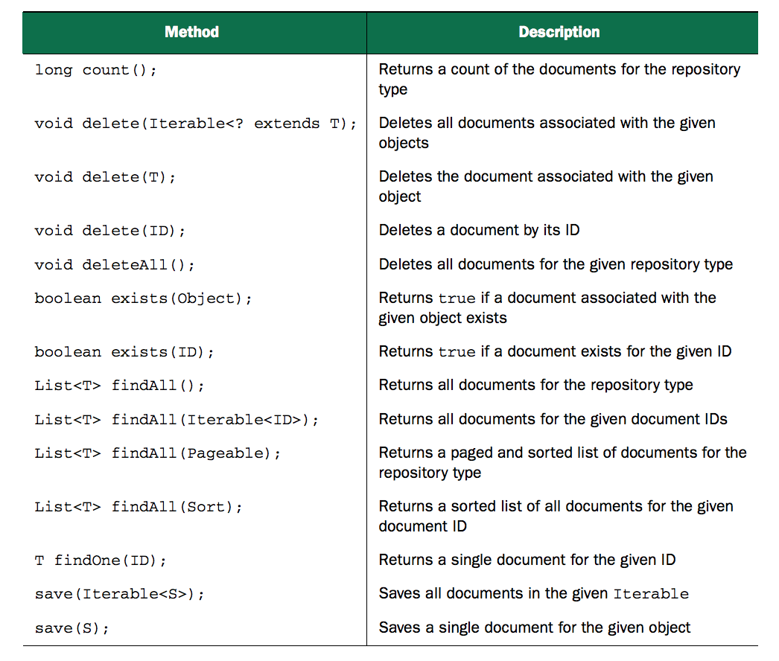
CRUD Operation by MongoRepository

Slide 10
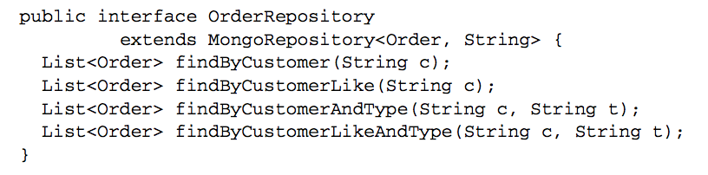

Adding Custom Query Methods
Spring Data MongoDB supports a method-naming convention that helps Spring Data to automatically generate implementation for the methods that follows that convention.
The verb “find” can be replaced by “get” or “read”

Slide 11

Specifying Queries
@Query annotation can be used to specify custom query
“type” property should be mapped to zeroth parameter of the query method
Takes JSON query string

Slide 12
Install MongoDB
Two Steps:
brew install mongodb
mongod
Mongod enables primary daemon process for the MongoDB system. It handles data requests, manages data access, and performs background management operations.
By default, MongoDB listens for connections from clients on port 27017, and stores data in the /data/db directory.

Slide 13


